Slide 1


Slide 2
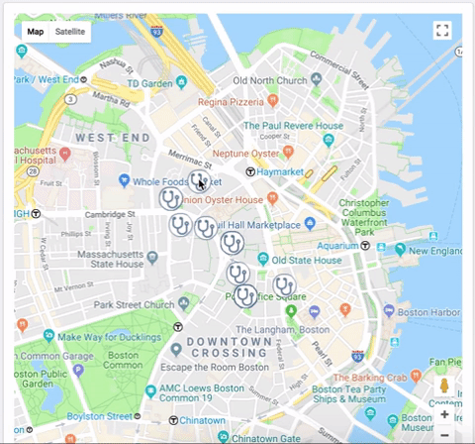

Slide 3
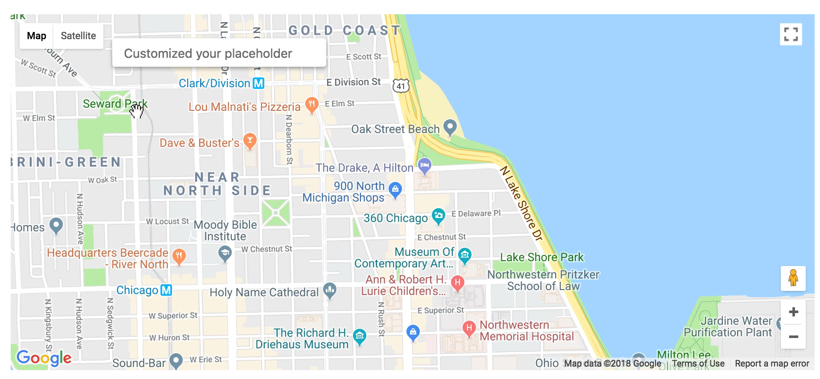

Slide 5
The link :
https://alikchaou.github.io/hakathon/index.php/index.html

